Slide 1

Minnesota

Slide 2
The Torch Run is the largest grassroots fundraiser and public awareness vehicle by law enforcement officers for
Special Olympics.
Here’s why…

Slide 3
Background
Started in Kansas in 1981 by Chief Richard LaMunyon
Held worldwide
In 2016, $56 million was raised to support Special Olympics programs throughout the world

Slide 4
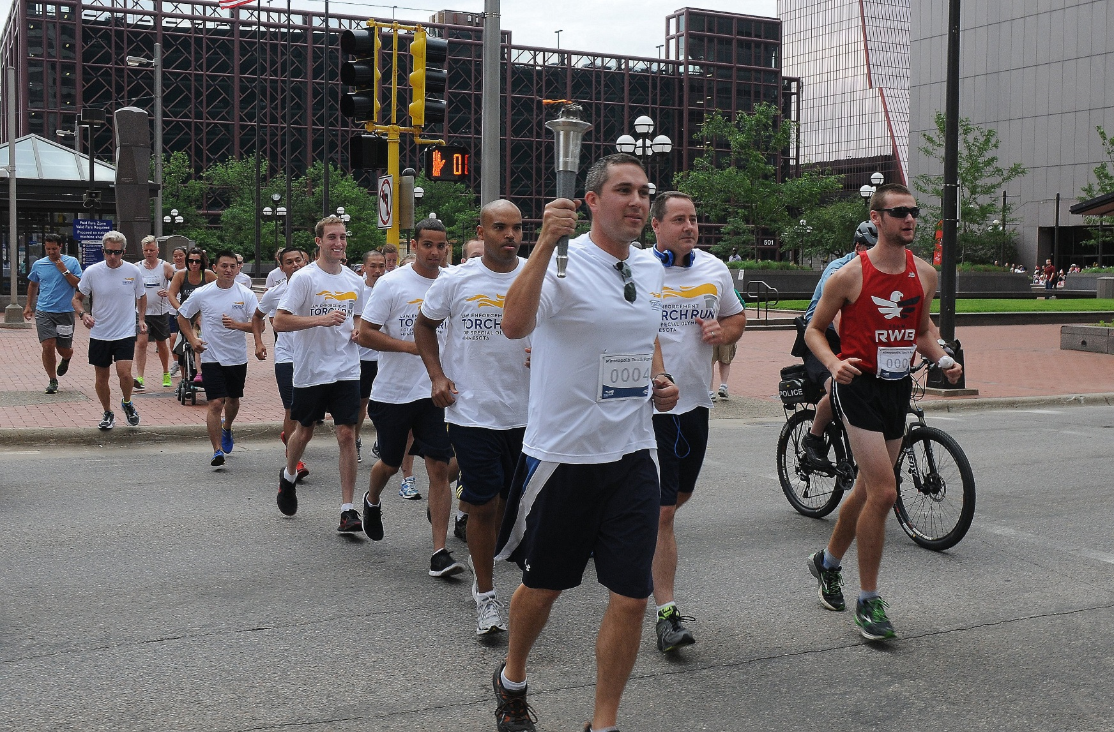
Running’s not all we do…

Slide 5
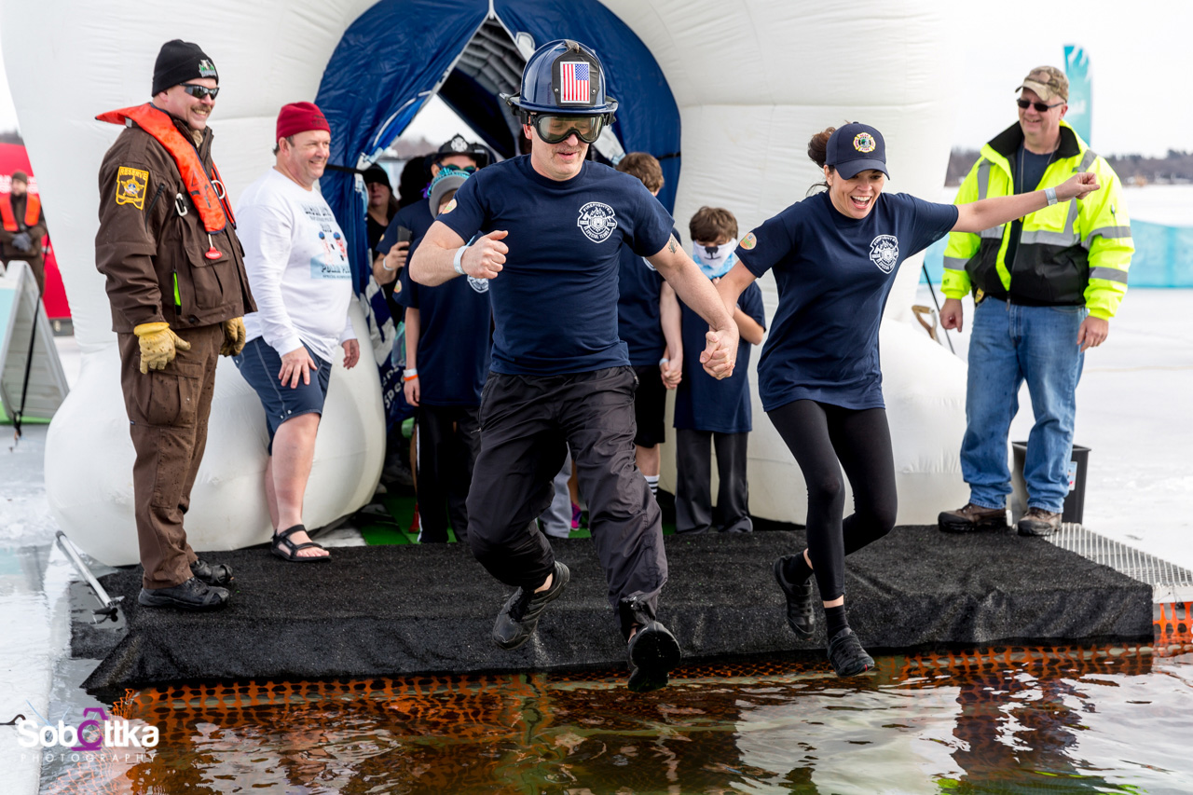

There’s the Polar Plunge…

Slide 6
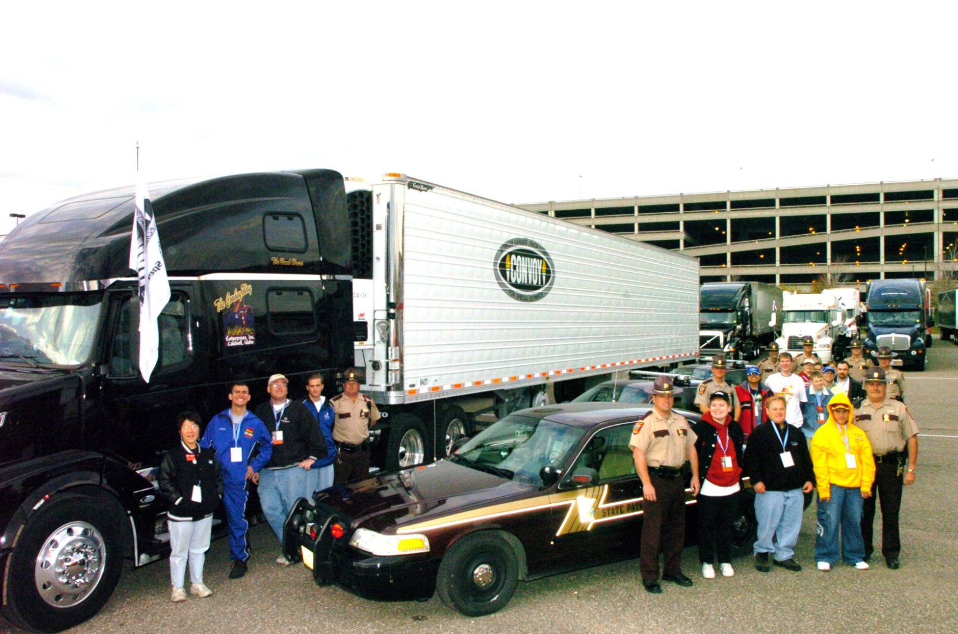
The world’s largest Truck Convoy…

Slide 7
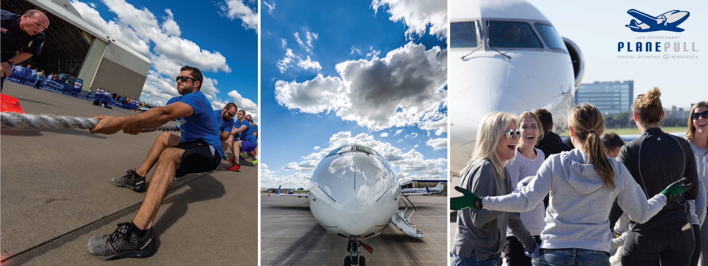
Plane Pull…

Slide 8
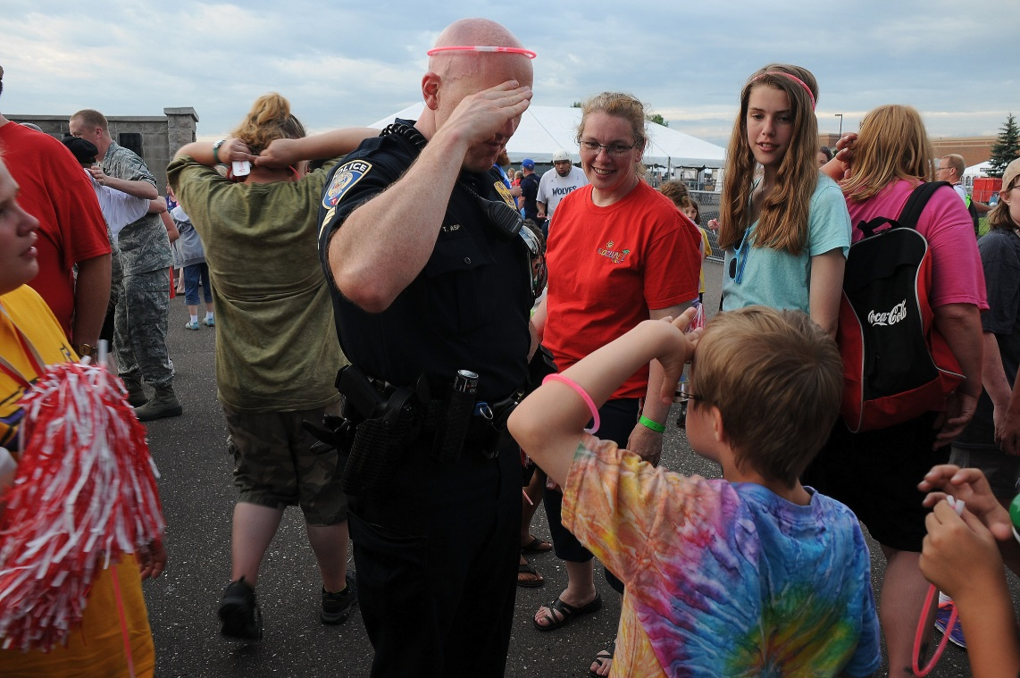
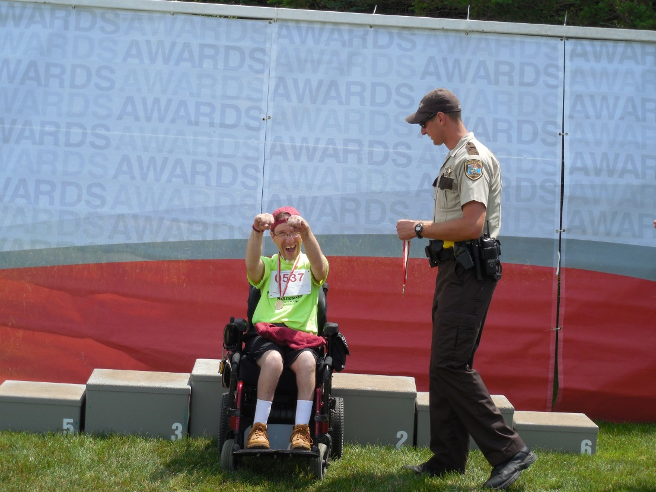
Statewide Competitions…

Slide 9
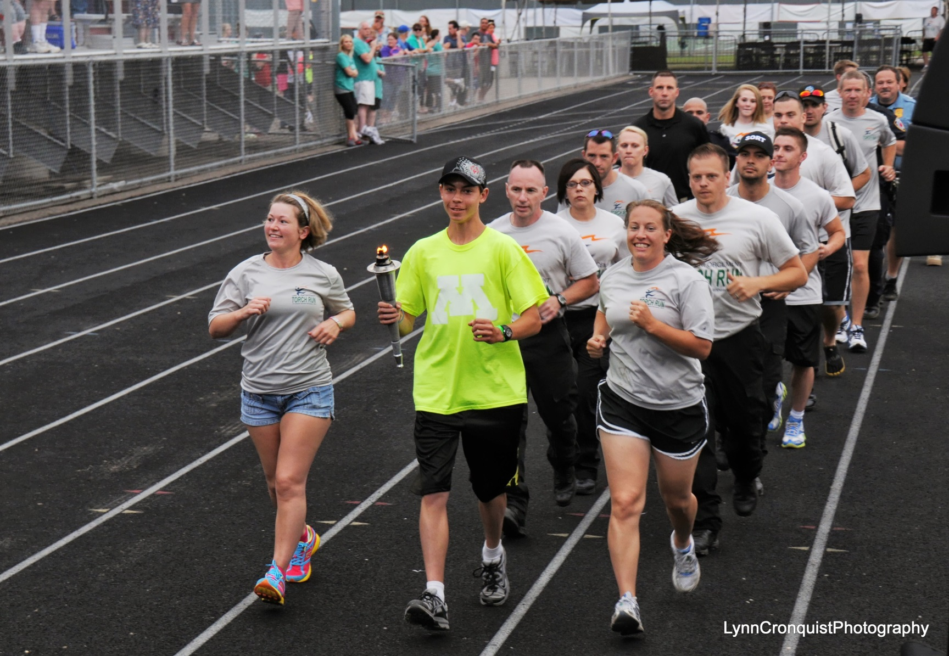
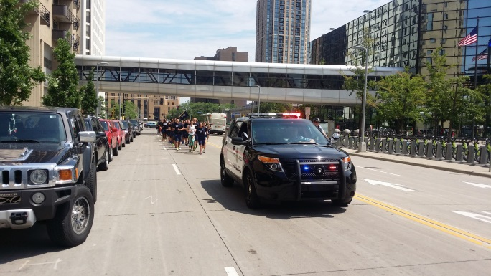
The Final Leg…

Slide 10



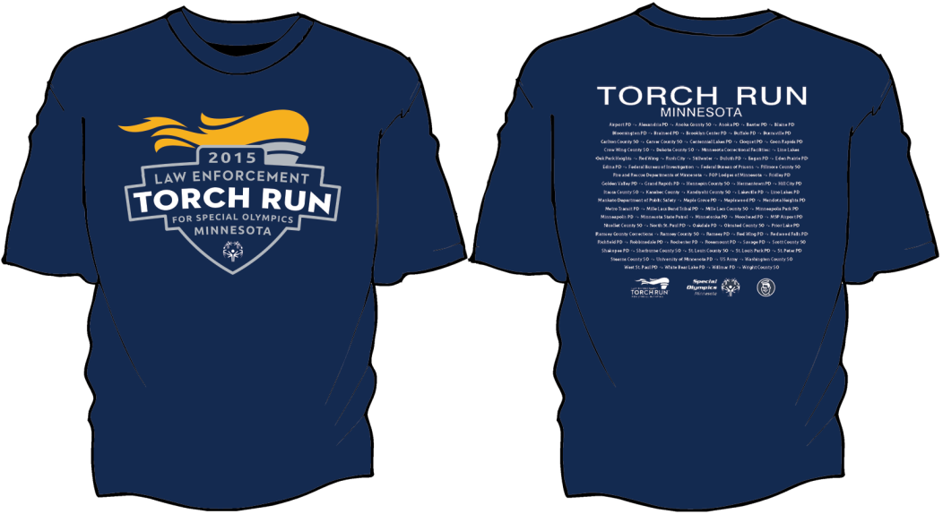
And much, much more!

Slide 11
The question isn’t
“When will you make a difference in the lives of our athletes?”

Slide 12
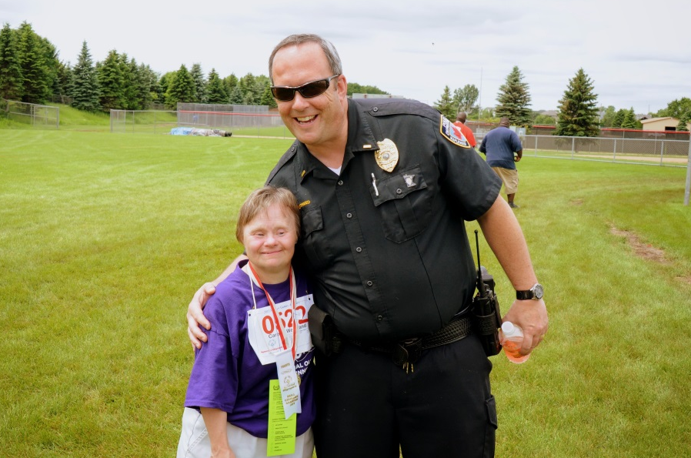
The question is
“When will you let them make a difference in yours?”

Slide 13
Here’s how…
Hand out awards
Sell Torch Run T-shirts
Run/bike/walk in the Final Leg
Volunteer/participate in events
Host a fundraising event
Contact us to get started!
Email Molly at molly.swanson@somn.org

Slide 14
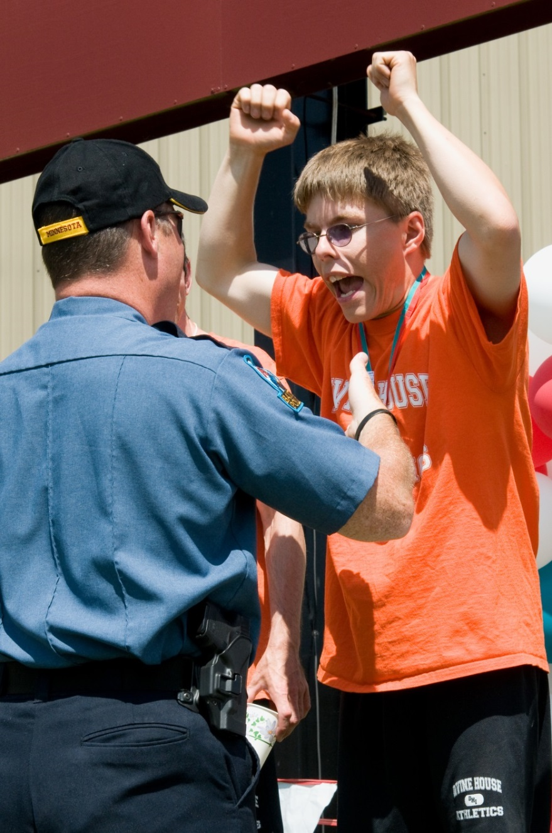
Thanks to all of you who continue to make a difference for our athletes and their families.

Slide 15
